Slide 1
Regular Expressions
Unit 4- Chapter 1

Slide 2
Concept of regular expression
A RegEx, or Regular Expression, is a sequence of characters that forms a search pattern.
RegEx can be used to check if a string contains the specified search pattern.
Python has a built-in package called re, which can be used to work with Regular Expressions.
import re
For example,
^a...s$
The above code defines a RegEx pattern. The pattern is: any five letter string starting with a and ending with s

Slide 3
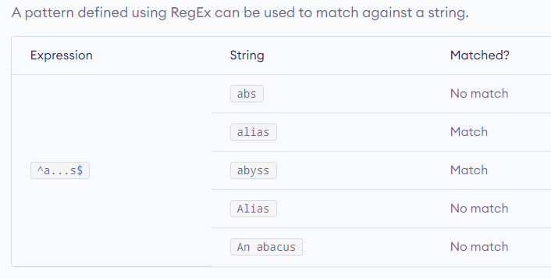

Slide 4
example
import re
pattern = '^a...s$'
test_string = 'abyss'
result = re.match(pattern, test_string)
if result:
print("Search successful.")
else:
print("Search unsuccessful.")

Slide 5
Specify Pattern Using RegEx
To specify regular expressions, metacharacters are used. In the above example, ^ and $ are metacharacters.
Metacharacters are characters that are interpreted in a special way by a RegEx engine. Here's a list of metacharacters:
[] . ^ $ * + ? {} () \ |

Slide 6
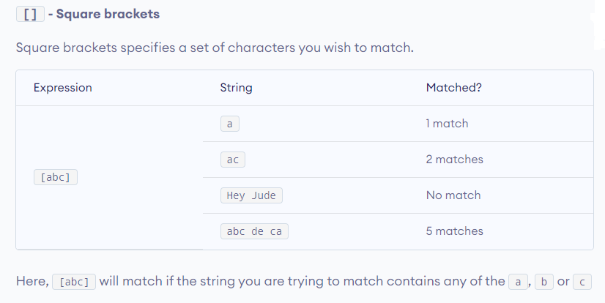

Slide 7
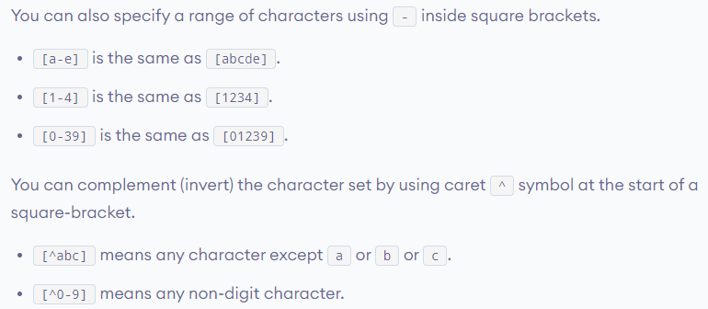

Slide 8
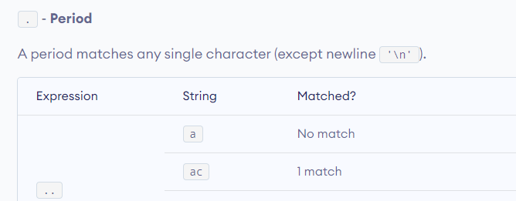
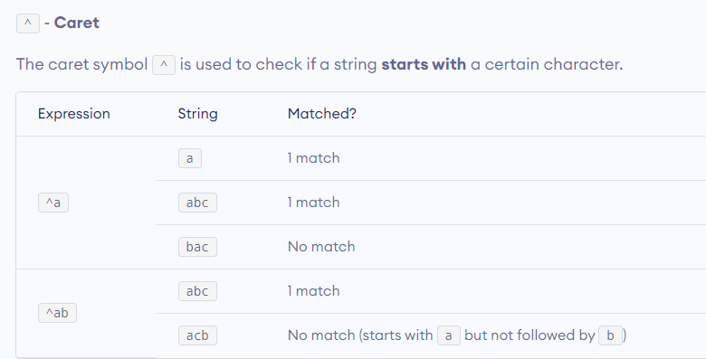

Slide 9
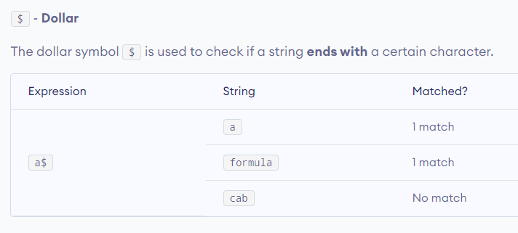

Slide 10
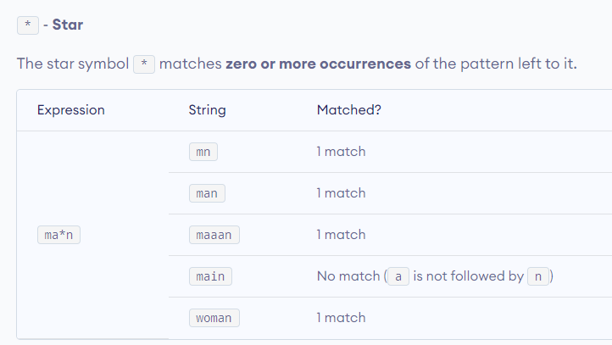

Slide 11
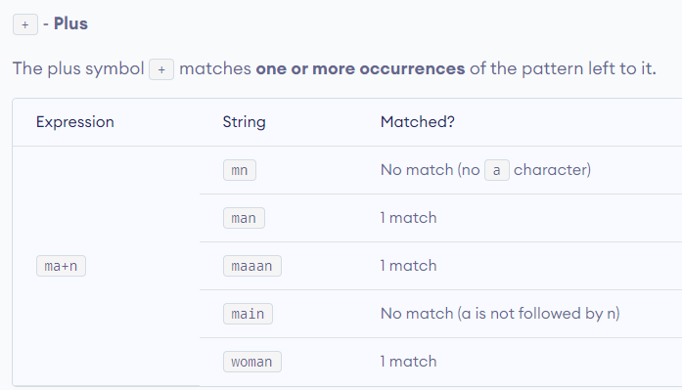

Slide 12
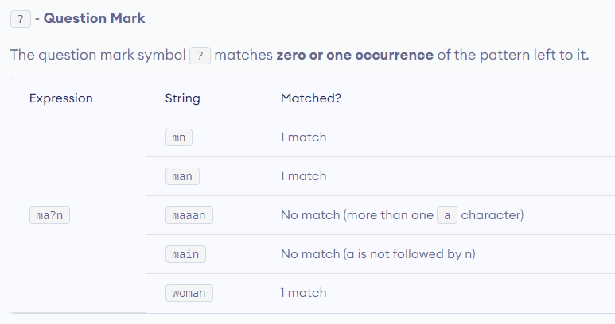

Slide 13
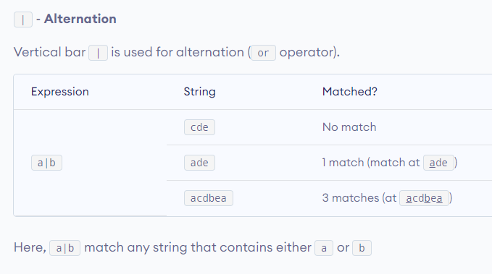

Slide 14
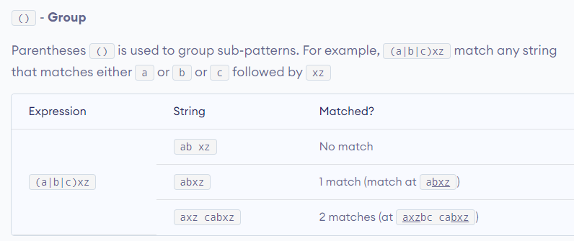

Slide 15
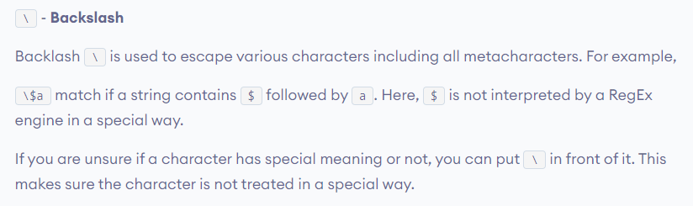
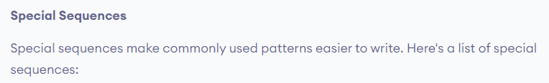

Slide 16
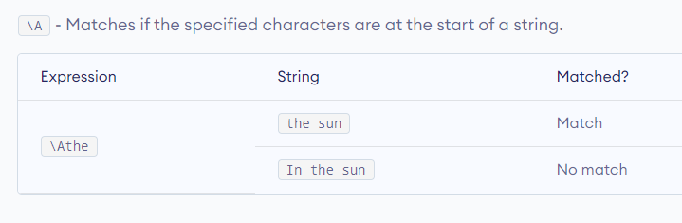

Slide 17
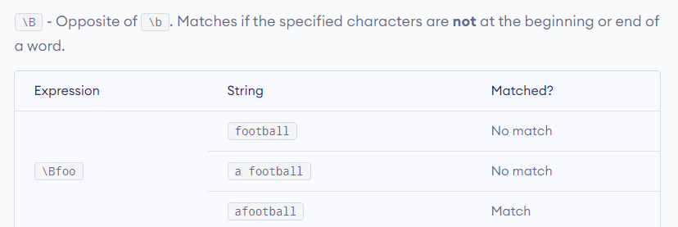
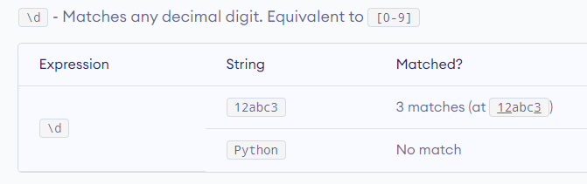

Slide 18
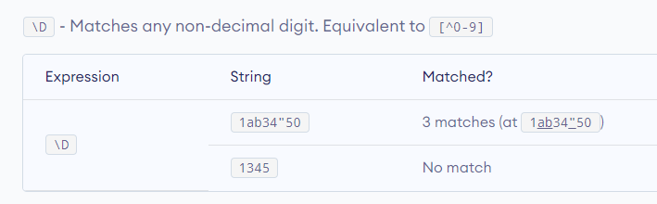
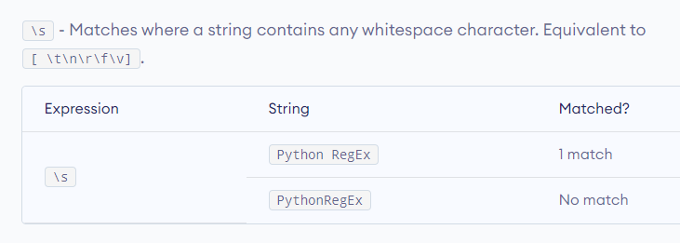

Slide 19
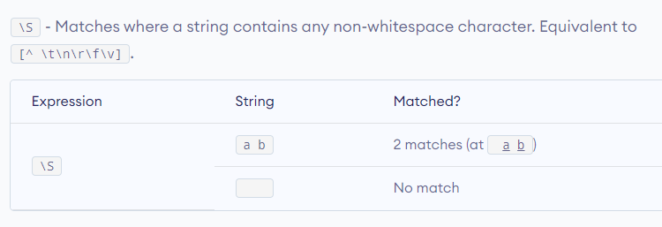
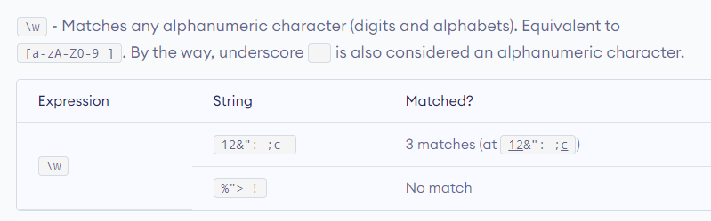

Slide 20
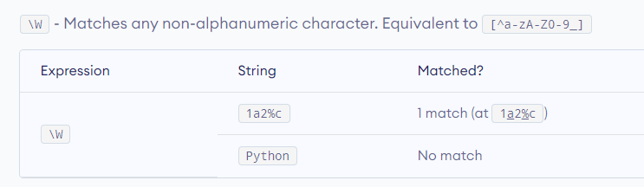

Slide 21
re.findall() function
# Program to extract numbers from a string
import re
string = 'hello 12 hi 89. Howdy 34'
pattern = '\d+'
result = re.findall(pattern, string)
print(result)

Slide 22
re.split() function
import re
string = 'Twelve:12 Eighty nine:89.'
pattern = '\d+'
result = re.split(pattern, string)
print(result)
# Output: ['Twelve:', ' Eighty nine:', '.']

Slide 23
import re
string = 'Twelve:12 Eighty nine:89 Nine:9.'
pattern = '\d+'
# maxsplit = 1
# split only at the first occurrence
result = re.split(pattern, string, 1)
print(result)
# Output: ['Twelve:', ' Eighty nine:89 Nine:9.']

Slide 24
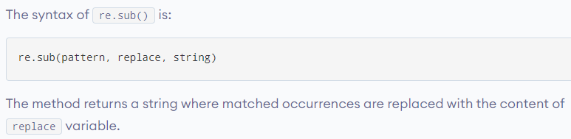
re.sub() function

Slide 25
# Program to remove all whitespaces
import re
# multiline string
string = 'abc 12\
de 23 \n f45 6'
# matches all whitespace characters
pattern = '\s+'
# empty string
replace = ''
new_string = re.sub(pattern, replace, string)
print(new_string)
# Output: abc12de23f456

Slide 26
import re
# multiline string
string = 'abc 12\
de 23 \n f45 6'
# matches all whitespace characters
pattern = '\s+'
replace = ''
new_string = re.sub(r'\s+', replace, string, 1)
print(new_string)
# Output:
# abc12de 23
# f45 6

Slide 27
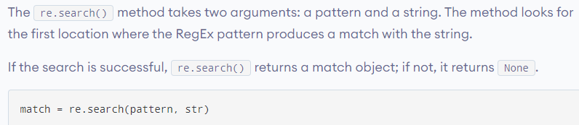
re.search() function

Slide 28
import re
string = "Python is fun"
# check if 'Python' is at the beginning
match = re.search('\APython', string)
if match:
print("pattern found inside the string")
else:
print("pattern not found")
# Output: pattern found inside the string

Slide 29
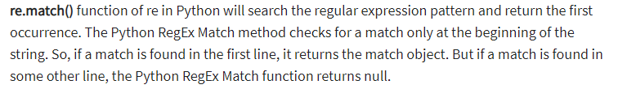
re.match() function

